Slide 1

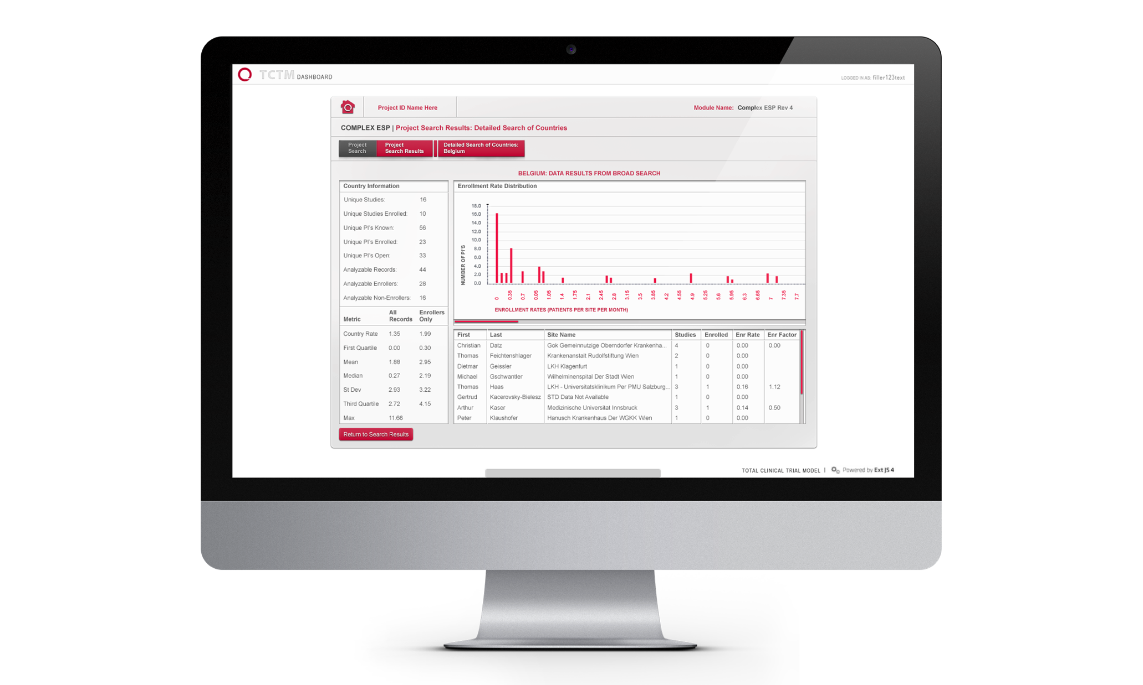
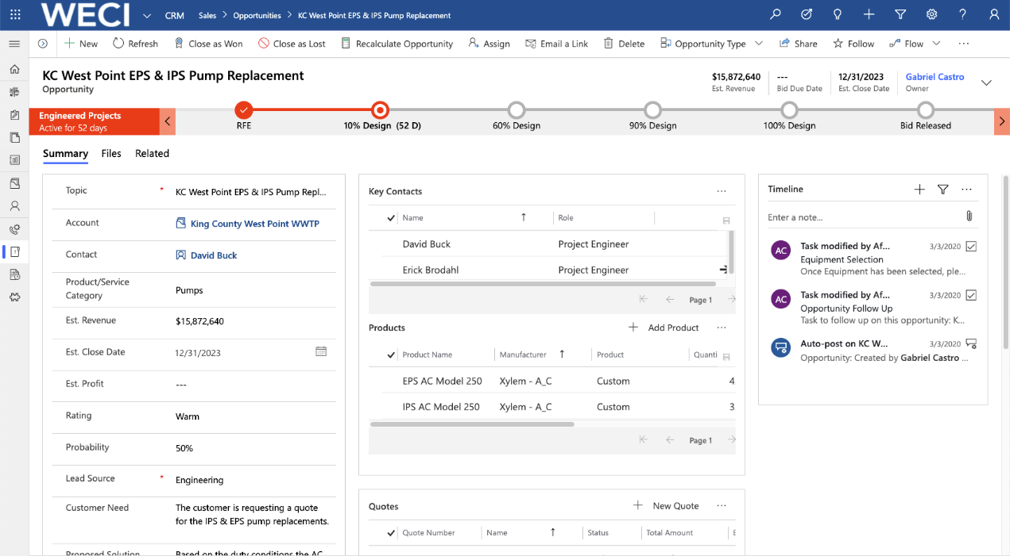
WECI – Dynamics 365 Implementation
Business Need
WECI is a leader in the fluid process industry, specializing in sales, engineering, and service for complex industrial equipment. WECI came to Affirma for support in designing and implementing a comprehensive CRM solution to manage their Sales, Engineering, Service and Account management lifecycle. Their goal was to build a central source of truth for the organization to manage complex account relationships, sales cycles, and service delivery.
Scope of Partnership
Defining and redesigning core business processes
Designing technical approach, architecture & data model
CRM implementation, development, integration, deployment, training & end user change management.
Ongoing managed service support with Business Analyst, Technical Lead, and Development teams.

